Slide 1
Prediction Physical and Chemical Properties of Soil using Spectral Measurements
Ali Asudegi, Mohammad
Zokaeinikoo, Maryam
Agara Mallesh, Dhanush

Slide 2
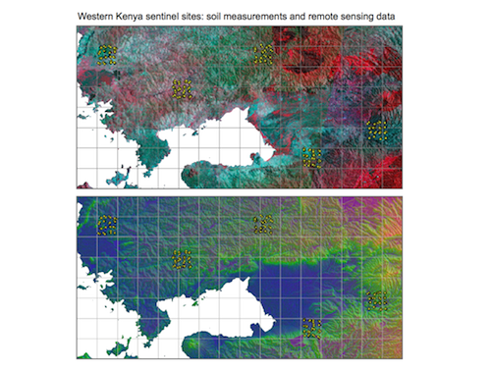
Introduction
An increasingly interest for using infrared spectroscopy for predicting soil functional properties at unsampled locations and to provide data for digital soil mapping
Highly repeatable, rapid, non-destructive and low cost measurement technique
The diffuse reﬂectance spectroscopy technique is largely general, quite weak and broad due to overlapping absorptions of soil constituents and their often small concentrations in soil
The information needs to be mathematically extracted from the spectra so that they may be correlated with soil properties
The analysis of soil diffuse reﬂectance spectra requires the use of multivariate calibration
Spectra must be related to a set of known reference samples through a calibration model

Slide 3
Problem Statement
Prediction of the functional properties of the soil using reflectance infrared spectroscopy.
A device will be used to record amount of absorbed infrared by a sample of soil at each wave number with predefined frequency.
Investigating samples from all over a specific area and reflecting predicted properties in pixels as a grid map will result in a map which can be used for decision making regarding investments such as where to grow specific types of agriculture’s products.

Slide 4
Data Structure
PIDN: Unique soil sample identifier
Predictors:
SOC: Soil organic carbon
pH: pH values
Ca: Mehlich-3 extractable Calcium
P: Mehlich-3 extractable Phosphorus
Sand: Sand content

Slide 5
Data Structure
Variables:
m7497.96 - m599.76: There are 3,578 mid-infrared absorbance measurements.
Depth: Depth of the soil sample (2 categories: "Topsoil", "Subsoil")
BSA: average long-term Black Sky Albedo measurements from MODIS satellite images (BSAN = near-infrared, BSAS = shortwave, BSAV = visible)
CTI: compound topographic index calculated from Shuttle Radar Topography Mission elevation data
ELEV: Shuttle Radar Topography Mission elevation data
EVI: average long-term Enhanced Vegetation Index from MODIS satellite images.
LST: average long-term Land Surface Temperatures from MODIS satellite images (LSTD = day time temperature, LSTN = night time temperature)
Ref: average long-term Reflectance measurements from MODIS satellite images (Ref1 = blue, Ref2 = red, Ref3 = near-infrared, Ref7 = mid-infrared)
Reli: topographic Relief calculated from Shuttle Radar Topography mission elevation data
TMAP & TMFI: average long-term Tropical Rainfall Monitoring Mission data (TMAP = mean annual precipitation, TMFI = modified Fournier index)

Slide 6
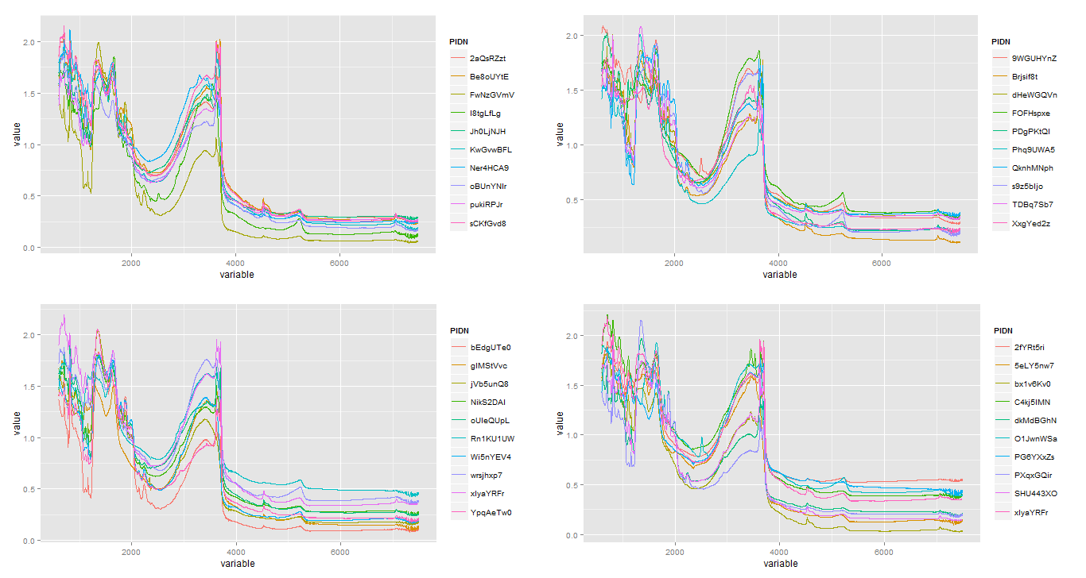
Visualization of Data
Topsoil
Subsoil
With CO2 Spectra
Without CO2 Spectra

Slide 7
Model Assessment
Pre-processing
Training
Prediction
Comparison

Slide 8
Pre-processing
Multiple Scatter Correction
Corrects the scatter in the spectra
First Derivative of the transformation
Reduces baseline offset
Can resolve absorption overlapping
Enhances small spectral absorptions
Discrete Wavelet Transform
Pairs the input values, storing the difference and passing the sum.
Savitzky – Golay Filter results in higher RMSE

Slide 9
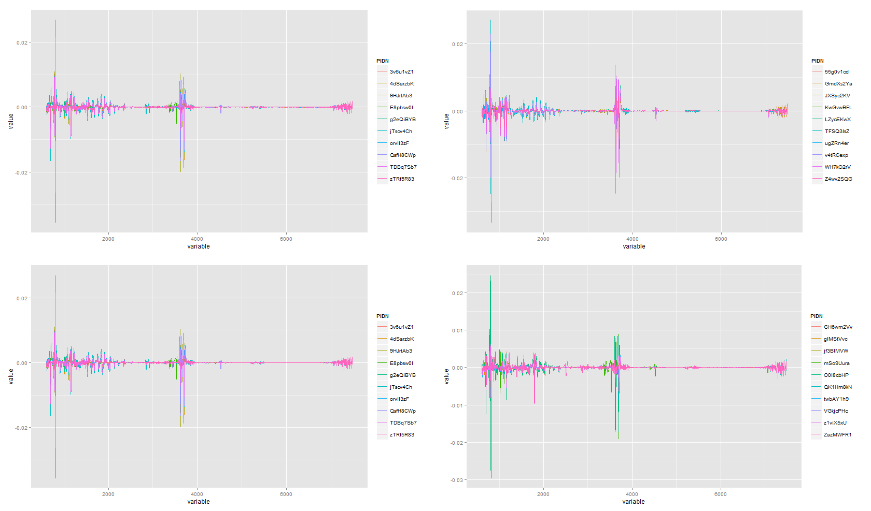
Savitzky – Golay Filter
Topsoil
Subsoil
With CO2 Spectra
Without CO2 Spectra

Slide 10
Training
The models were trained using 5 different methods
Partial Least Squares
k – Nearest Neighbor
Random Forest
Support Vector Machines
Linear Regression

Slide 11
Comparison of Root Mean Squared Error Values

Slide 12
Conclusion
From the comparison of the RMSE values, we choose the training method with the lowest value for prediction of the variables.
The training methods used for the predictor variables are:
Ca - Random Forest
P – Random Forest
pH – Support vector machines
SOC – Linear regression
Sand – Linear regression

Slide 13

Questions

